Slide 1
Street Segment Analysis of Juvenile Crime in Trenton
Louis Tuthill, Ph.D.
Assistant Professor of Criminology
Department of Sociology, Anthropology, and Criminal Justice
Rutgers, The State University of New Jersey

Slide 2
Table of Contents
Juvenile Crime vs. Adult Crime
Point Pattern Analysis
Street Segment Analysis
Juvenile Incidents in Trenton
  Area 1
  Area 2
  Area 3
  Area 4
  Area 5

Slide 3
Juvenile Crime vs. Adult Crime
In studying Juvenile Crime we attempt to pick at risk youth and address the “risk” and “protective” factors that impact individual youth
  Effective programs are expensive and address cognitive and behavioral change at the individual and familial level
  Individual level information can also be used to assess networks of juveniles engaged in criminal behavior
Challenges with model:
  Cost of treating individuals
  Labeling youth as “criminal” or “at risk” can create other issues
  Effective targeting of resources to address needs

Slide 4
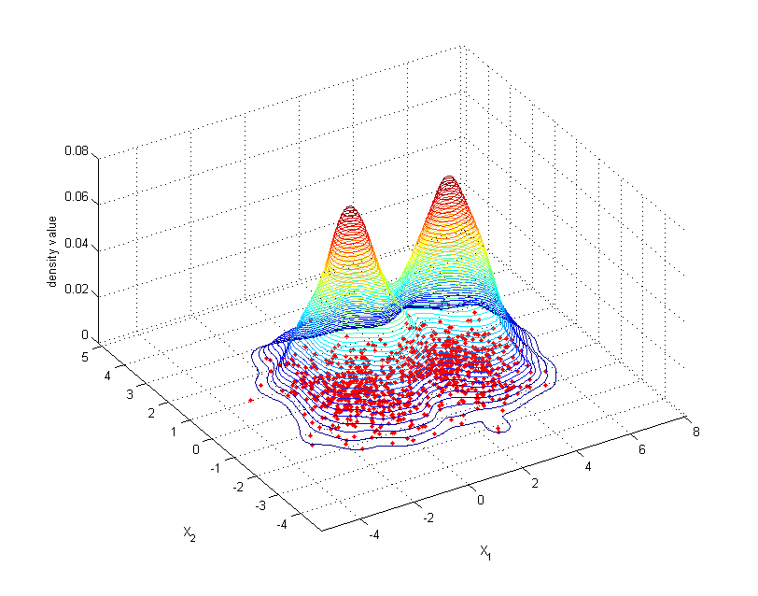
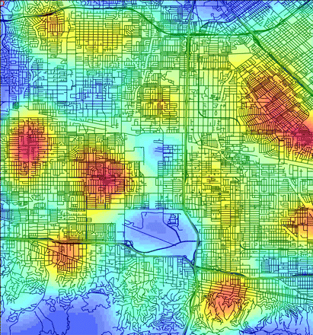
Point Pattern Analysis
Takes all these points (kernel) and maps them into positions based on the closeness of these incidents (KDE)
Measures the density or closeness of the same criminal event
Provides cross-sectional rendering of crime events
Rendering includes several streets and statistical “white noise”

Slide 5
Street Segment Analysis
Maps event to the nearest street
Uses a density function LISA (Local Indicator of Spatial Autocorrelation)
  Provides a statistical measure of street segments where crime cluster high
  We then look to each individual street segment which are separated by one segment. This gives us street segment clusters.
  Then we can examine each of these street segments, based on the crime and the physical environment, see what factors might be contributing to crime
  We can also then measure the change in these cluster over time

Slide 6
Incidents of Juvenile Arrests
January 2009 - May 2014

Slide 7
Identified 126 Street Segments
Segments make up 3.6% of Trenton's geographic space
48.7% all juvenile arrests occurred within one block of these areas
63.3% all juvenile arrests occurred within two blocks of these areas

Slide 8
Examined each set of street clusters
Looked for interconnection of streets
Examined if the event was acute or chronic (time and prevalence)
Looked at crimes within one standard block (330 feet) of these street segments
We will examine the crime typology and the discuss how to best address the crime

Slide 9
Area 1

Slide 11
Area 1: Demographic Breakdown

Slide 12
Notes:
This chart is difficult to read: Can you just list the top 5 times of day and the percentage?

Slide 13
Notes:
This chart is also difficult to read – can you just explain the general trend?

Slide 15
Area 1
Predominantly drug use and related crimes
Mostly among Black males
Considerable uptick in activity between 8 and 11 pm
Significant jump in juvenile arrest in 2011 – seems to have subsided
Late onset delinquency related to drug use

Slide 16
Area 2

Slide 18
Area 2: Demographic Breakdown

Slide 19
Notes:
This chart is difficult to read: Can you just list the top 5 times of day and the percentage?

Slide 21
Notes:
Dark blue is area 1 light blue is area 2

Slide 23
Area 2
Predominantly drug related offenses
  More variety in type of criminal activity
Mostly black males
Both time lines show general increase in juvenile crimes in 2011 – drop off beginning June 2012
  It appears that efforts in Area 1 pushed delinquency into Area 2
  We need more data to see if crime in Area 2 was disbursed or moved
Different timeline than Area
  Morning crimes
  Afternoon crime (related to property crimes)
  Evening crimes (related to drug markets)
Late onset delinquency related to drug use

Slide 24
Area 3

Slide 26
Area 3: Demographic Breakdown

Slide 27
Notes:
This chart is difficult to read: Can you just list the top 5 times of day and the percentage?

Slide 30
Area 3
Predominantly drug related activity
  Other crimes: weapons, burglary, & stolen property
    Related to the drug market
    Related to need to generate incomes
Mostly black males
Uptick in criminal activity in early afternoon and evening
Different time of year pattern from Areas 1 and 2
  Important to note differences in time of day and time of year for resource allocation purposes
Late onset delinquency

Slide 31
Area 4

Slide 33
Area 4: Demographic Breakdown

Slide 34
Notes:
This chart is difficult to read: Can you just list the top 5 times of day and the percentage?

Slide 37
Area 4
Predominantly drug related activity
More violent area – chief illicit commodity appears to be weapons
  First case of robbery in Area 4
Mostly among black males
Most activities occurred in the evening
Late onset of delinquency

Slide 38
Area 5

Slide 40
Area 5: Demographic Breakdown

Slide 41
Notes:
This chart is difficult to read: Can you just list the top 5 times of day and the percentage?

Slide 44
Area 5
Predominantly drug use and related crimes
Mostly among black males
Stable drug market
Activity occurred throughout the day
Late onset delinquency

Slide 45
Overall analysis
Overall it appears that the serious juvenile crime is spurred by drug markets
This began in 2009 and has moved around the city in an overall upward swing
It appears that older juveniles are being incorporated into current drug markets
  Older juveniles appear to be used to transport illicit merchandise
Juveniles are also arming themselves for protection
Juveniles appear to be reacting effectively to law enforcement responses by moving around the city

Slide 46
Overall analysis
Arrest of this population has been found to be the worst response
Most of the factors with regard to late onset have much more to do with peer-group, labeling, and family dynamics
If we are going to intervene we need to do it in late-middle or early-high school
We need consistent effort target at this population because we are generally competing with the gangs
From the Trenton adult data this age becomes the launching point where individuals begin to engage in more serious crime

Slide 47
Louis Tuthill, Ph.D.
Assistant Professor of Criminology
Department of Sociology, Anthropology, and Criminal Justice
Rutgers, The State University of New Jersey

